Slide 1

Speech Emotion Recognition with librosa Python
Team Members: -
MTV Soumith (2010030097)
C.Koushik Reddy(2010030027)
D.Chaitanya(2010030045)
TSS Subramanyam(2010030167)

Slide 2
Abstract
Emotion recognition is a rapidly growing research domain in recent years. Unlike humans, machines lack the abilities to perceive and show emotions.
But human-computer interaction can be improved by automated emotions recognition, thereby reducing the need of human intervention. In this project, we are going to implement four basic emotional speech signals (Anger, Happy, Fear and Neutral).

Slide 3
INTRODUCTION
Human computer interaction will be natural and effective when the interfaces are sensitive to human emotion or stress. Previous studies were mainly focused on facial emotion recognition, but speech emotion detection is gaining importance due its wide range of applications. Speech emotion recognition still remains a challenging task in the field of affective computing as no defined standards exist for emotion classification. Speech signal carries large information related to the emotions conveyed by a person. Speech recognition system fails miserably if robust techniques are not implemented to address the variations in speech due to emotion. Emotion detection from speech has two main steps. They are feature extraction and classification. The goal of this project is to give an overview on the types of corpus, features and classification techniques that are associated with speech emotion recognition.

Slide 4
SNO | Name of the Title | Author | Tools | Pros | Cons
1 | Emotion detection from speech | Kashfia Sailunaz, Manmeet Dhaliwal, Jon Rokne & Reda Alhaj | Pycharm, Roboflow dataset | People express their emotions directly or indirectly through their speech | Extracting emotions behind these postings is an immense and complicated task.
2 | Analysis of Speech Features for Emotion Detection | Rode Snehal Sudhakar; Manjare Chandraprabha Anil | Pycharm, Librosa | Voice can communicate emotions. | Speaking is loud and invites noise to others.
3 | Iterative Feature Normalization Scheme for Automatic Emotion Detection from Speech | Carlos Busso Soroosh Mariooryad, Angeliki Metallinou, Shrikanth Narayanan | Pycharm,librosa,numpy | This technology solves inefficiencies and reduces wasted time. | Error and misinterpretation of words.

Slide 5

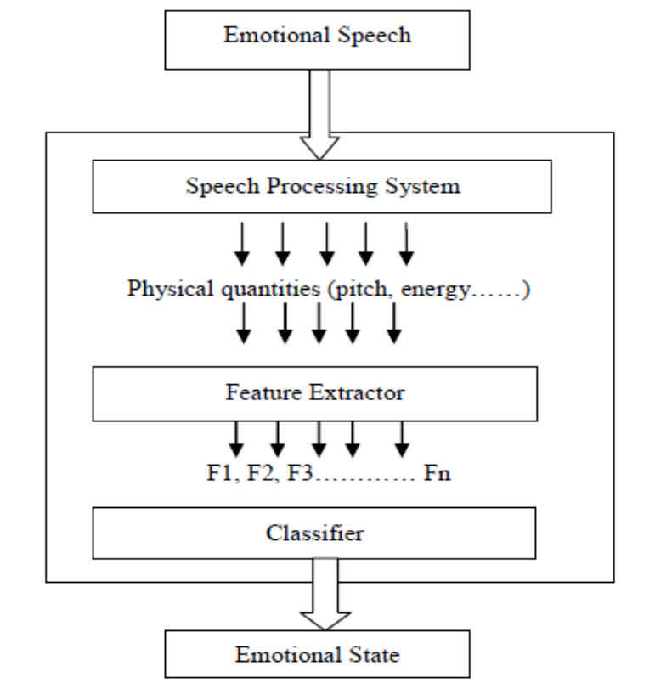
METHODS
In this Python mini project, we will use the libraries librosa, soundfile, and sklearn (among others) to build a model using an MLP Classifier. This will be able to recognize emotion from sound files. We will load the data, extract features from it, then split the dataset into training and testing sets. Then, we’ll initialize an MLPClassifier and train the model. Finally, we’ll calculate the accuracy of our model.
librosa is a Python library for analyzing audio and music. We are going to use this library in our project. It has a flatter package layout, standardizes interfaces and names, backwards compatibility, modular functions, and readable code. Further, in this Python mini-project, we demonstrate how to install it (and a few other packages) with pip.

Slide 6
Discussion
PROPOSED SYSTEM : -
In this project, we are going to use MLP Classifier as the feature for classifying the speech data into various emotion categories employing artificial neural networks.
The usage of the Neural Networks provides us the advantage of classifying many different types of emotions in a variable length of audio signal in a real time environment.
This technique manages to establish a good balance between computational volume and performance accuracy of the real-time processes.
ADVANTAGES OF PROPOSED SYSTEM: -
Can be implemented in any hardware supporting the python language.
Very fast in processing the audio and easy to use.
Variable length audio files are understood by the system.

Slide 7
Data Set
For this Python mini project, we’ll use the RAVDESS dataset; this is the Ryerson Audio-Visual Database of Emotional Speech.
This dataset has 7356 files rated by 247 individuals 10 times on emotional validity, intensity, and genuineness. The entire dataset is 24.8GB from 24 actors.

Slide 8
Conclusion
Through this project, we will show how we can leverage MLP Classifier to obtain the underlying emotion from speech audio data and some insights on the human expression of emotion through voice. This system can be employed in a variety of setups like Call Centre for complaints or marketing, in voice-based virtual assistants or chatbots, in linguistic research, etc.

